Slide 1
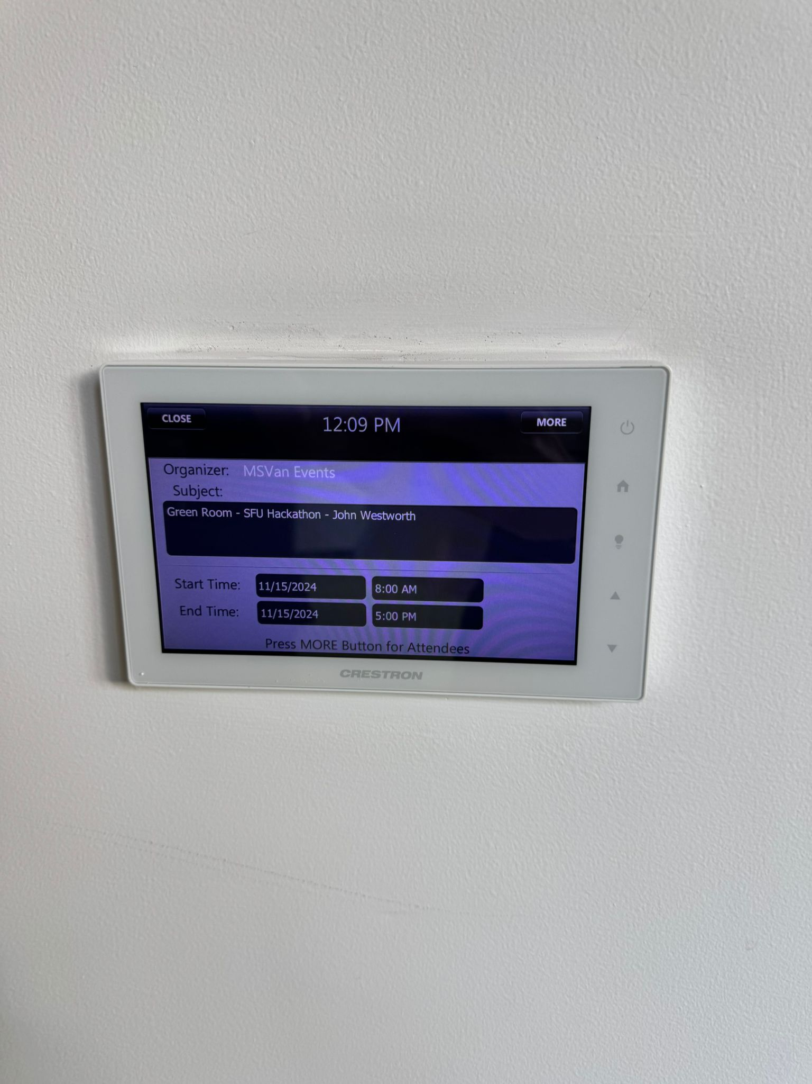
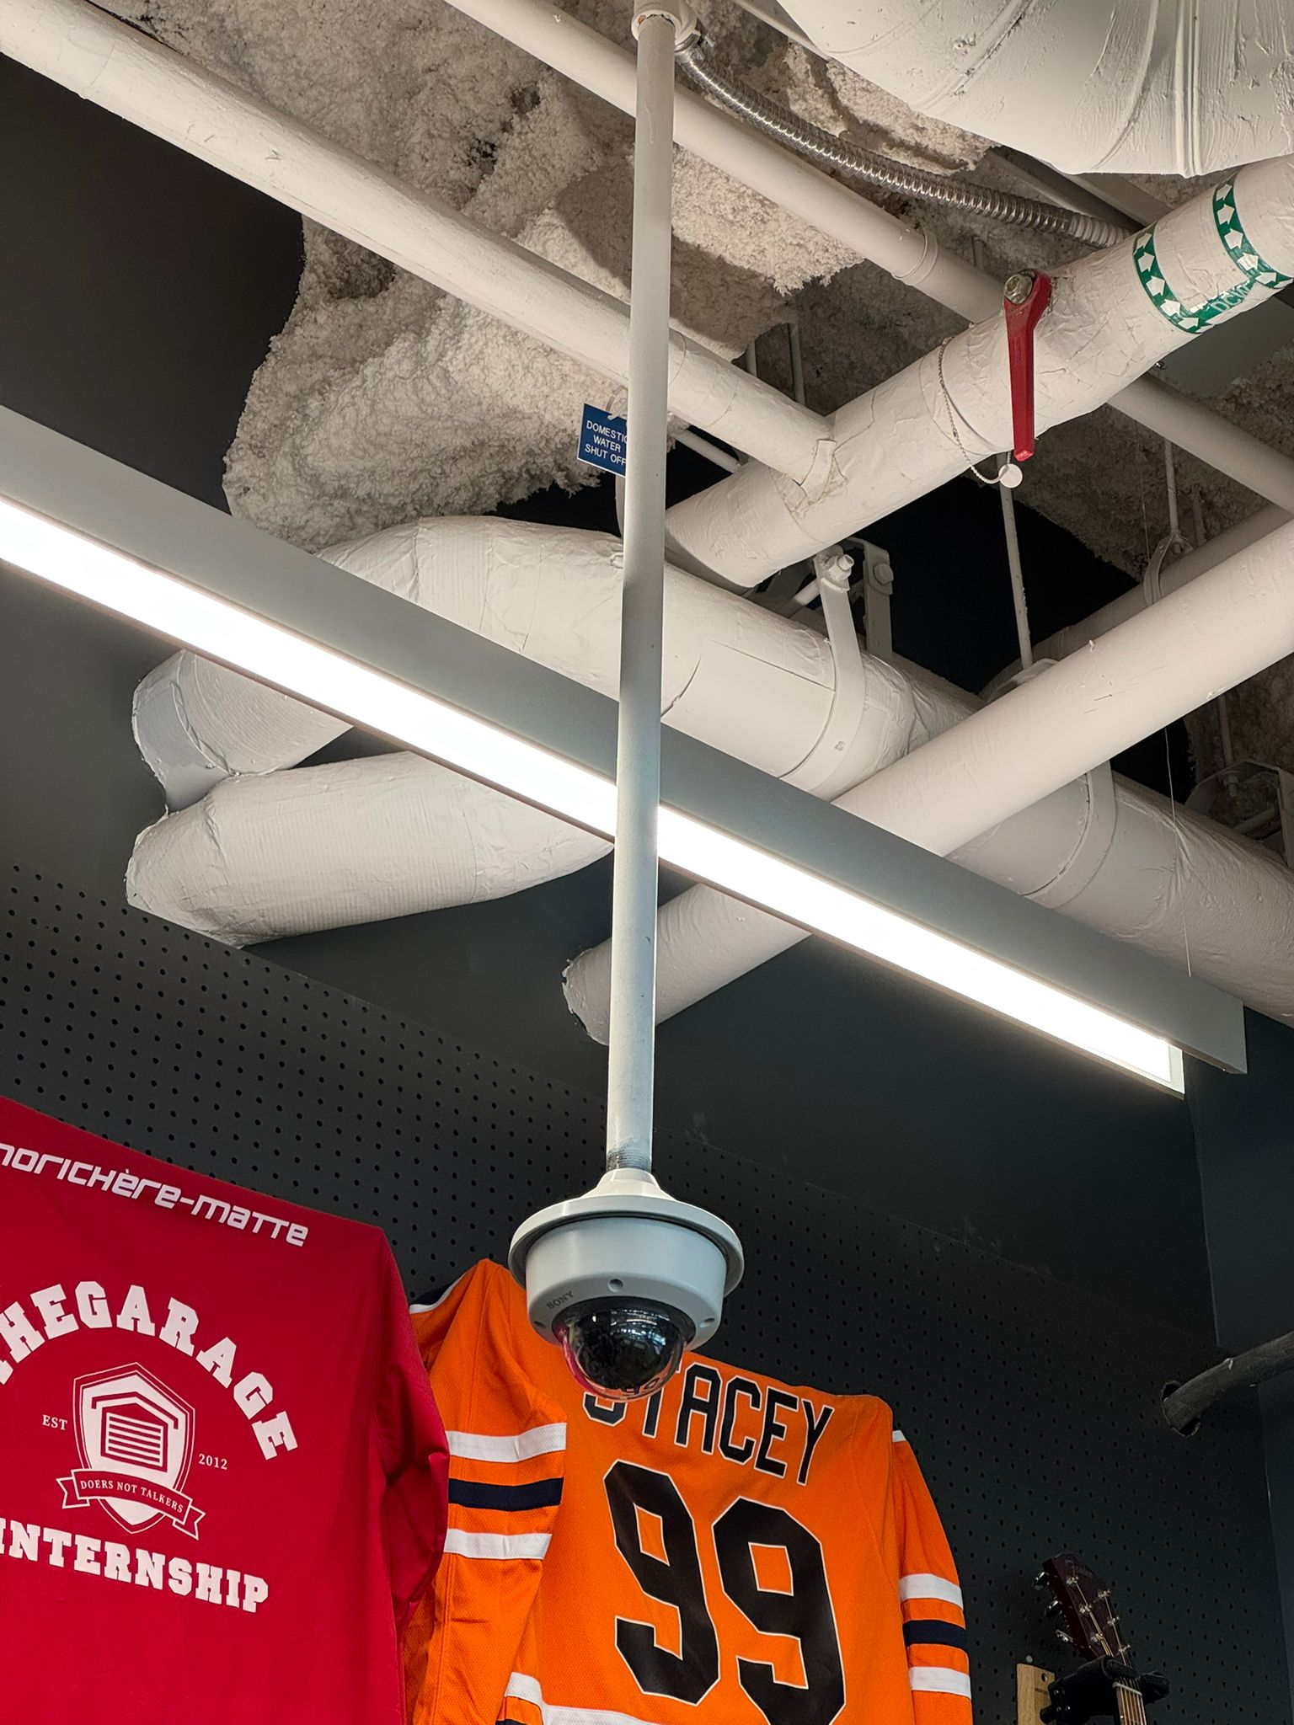
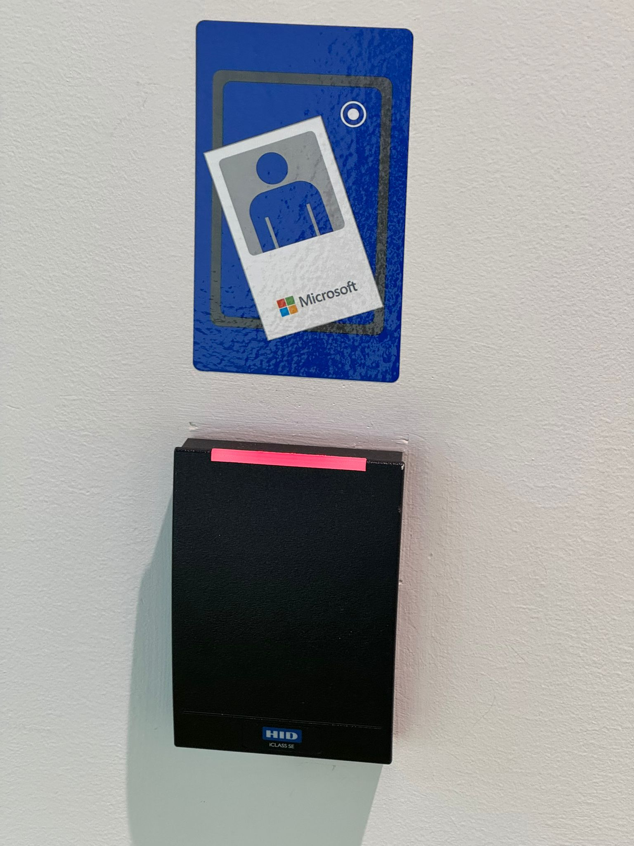
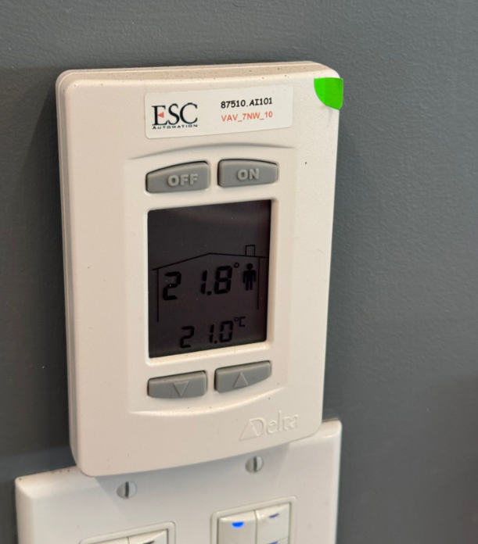

Slide 2
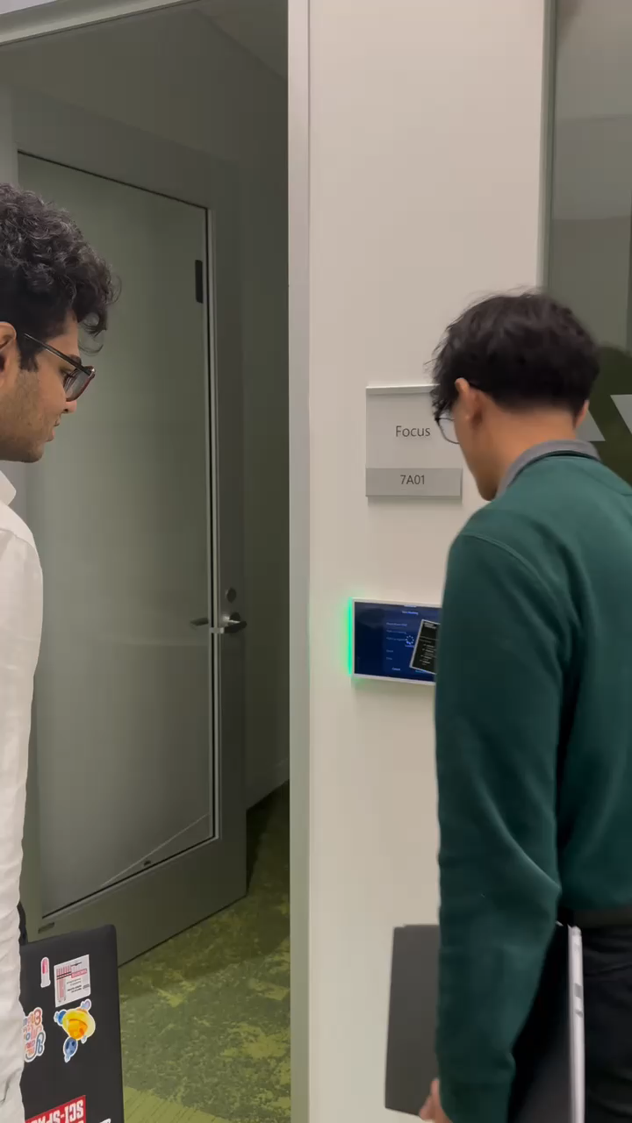

Slide 3
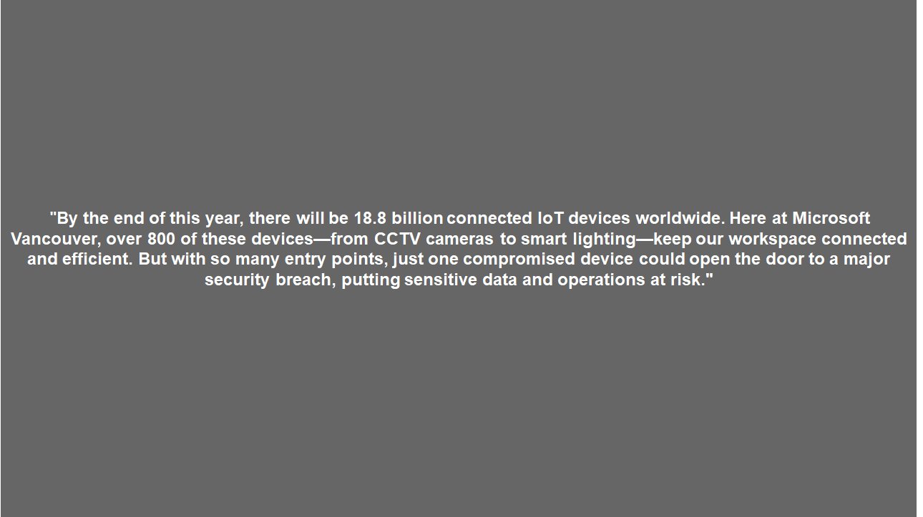

Slide 4

Securing the Future: A Centralized IoT Security Platform for Enterprise Environments
Presented to: Microsoft Sponsor
Presented by: X Consulting (Team 11)
Date: November 15, 2024
Knacky
Pranay
Chiraag
Karla

Slide 5
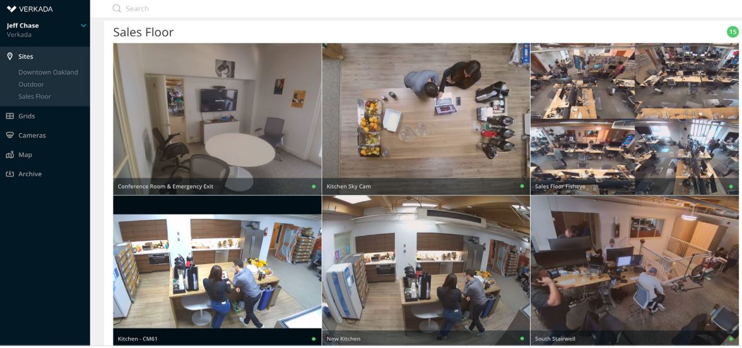
Securing IoT Devices in Enterprise Environments
Verkada Breach (2021)
Hackers accessed live feeds from 150,000 surveillance cameras.
Affected Sectors: Hospitals, police departments, and corporations.
Impact: Exposed sensitive areas and operations, highlighting IoT security vulnerabilities.
How can we develop a centralized IoT security platform with real-time monitoring, anomaly detection, and automated threat responses to prevent breaches like the Verkada incident?

Slide 6
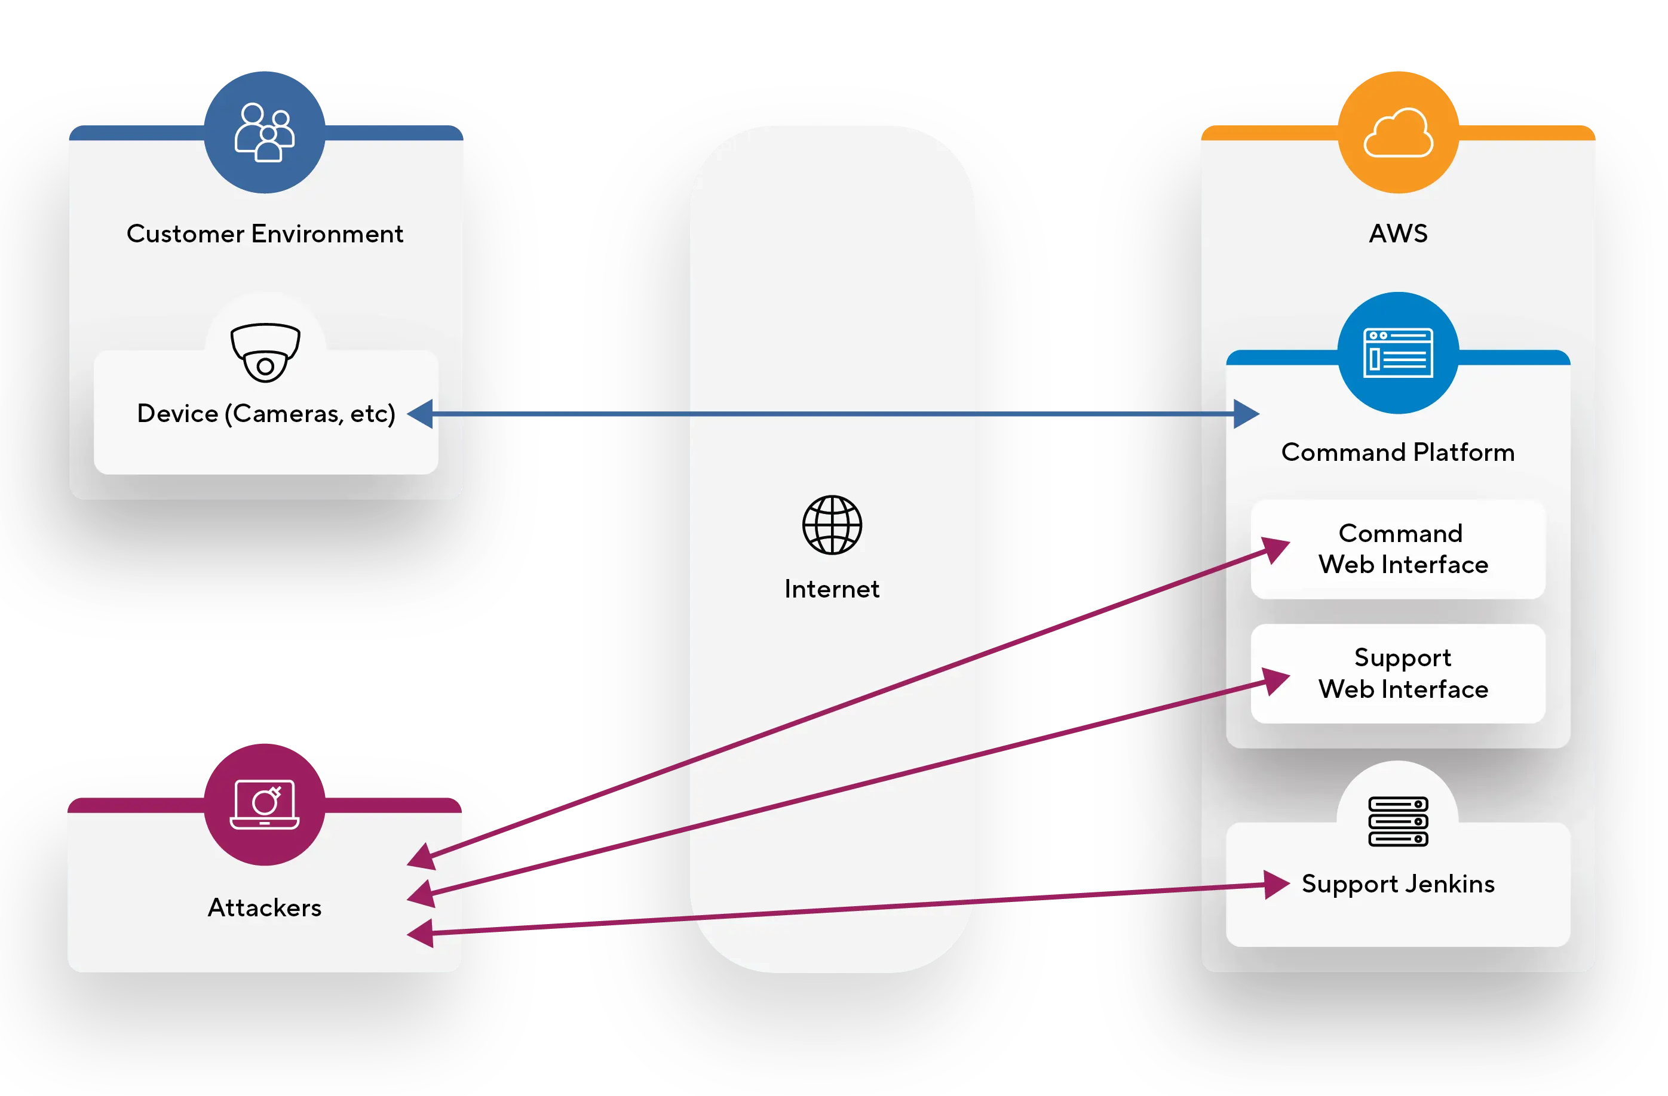
Securing IoT Devices in Enterprise Environments
Verkada Old System
Key Problems
Centralized Access Points
Insufficient Access Controls
Exposed Support Tools
No Real-Time Anomaly Detection

Slide 7
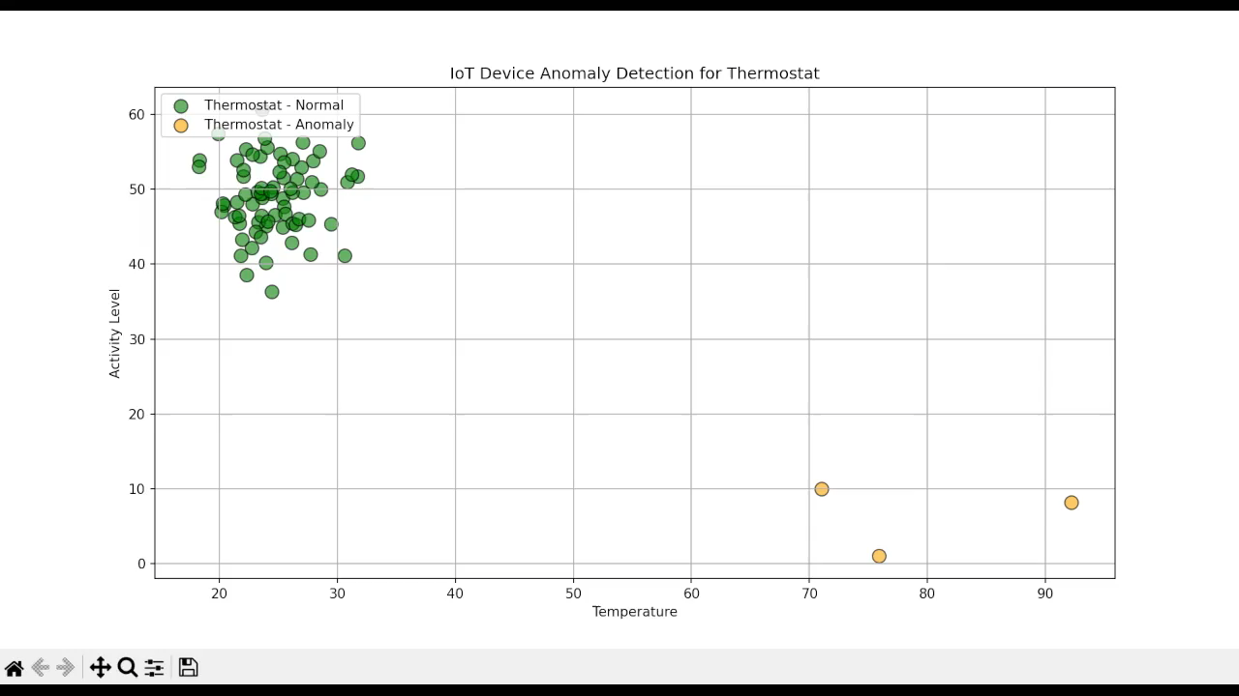
Our Recommendation: IoT Shield
Simulates IoT Data: Generates realistic telemetry for 400 devices with custom risk levels for each type (e.g., Cameras, Door Locks).
Anomaly Detection: Uses Isolation Forest to flag unusual device behavior in real-time based on temperature, activity, and battery metrics.
Dynamic Visualization: Animates anomalies by device type and risk status, providing clear, color-coded alerts for potential security threats.

Slide 8
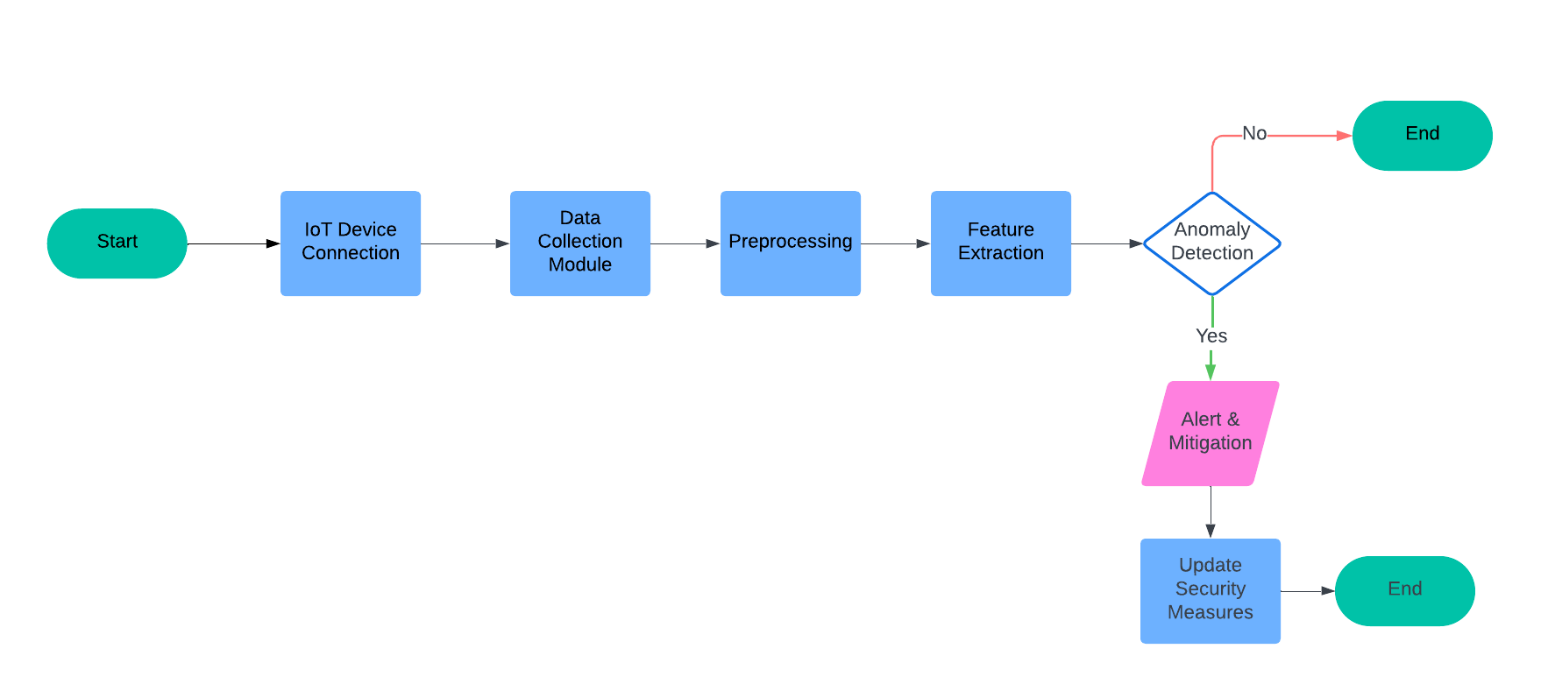
Our recommendation: IoT Shield
Flow Diagram

Slide 9
Feasibility (The How?)
Technical
Data Availability & Quality
Cost-Benefit
Assess IT infrastructure and scalability.
Detect abnormal activity to prevent attacks.
Ensure high-quality data sets.
Gradual rollout by department.
Compare costs with long-term benefits.
Offset costs by preventative measures.
Avoid financial losses from breaches.

Slide 10
Implementation Strategy and Timeline
2025
Action
Jan Feb Mar Apr May Jun Jul Aug Sep
Data Integration
Combine data from various sources
Ensure data is clean and unified.
Training
Use unique IoT identifiers to create baselines.
Flag outliers and testing
Pilot Testing and Deployment
Roll out by departments
Finalize and review organization wide
Continuous maintenance and improvements

Slide 11
Impact and Scalability:
1
Security
-Implementation of Realtime Analysis improves proactive security
2
Efficiency
-Centralized control provides more efficient response and reduces required resources
3
Scalability
-Utilization of Machine Learning continuously enhances its capabilities.

